Slide 1

EMINE23_03
RADIANT POWER
Waste2Watts Initiative
Team:
Aurora Jahan
Atilla Çakır
Jeevan George
Simran Mandal
Hadiza Ahmed
Faisal Ahmed Moshiur
Number of customers talked to: 11

Slide 2
Problem
What?
Energy solution to wireless sensors
Nuclear waste management
Sustainable energy solution
Why?
Accessibility in remote locations
Nuclear waste has big radiological impact
Reliable, Long-life battery
How?
Lifetime is more than 30 years
Reprocessed Sr-90

Slide 3
PRODUCT
DESCRIPTION
Developing and Commercializing Strontium Beta Voltaic Batteries
Converts energy from decaying beta particles into reliable and predictable electricity
Independent of temperature differences
Long lifespan
Sustainable and safe energy solution
Predictable
Powering small devices for various industries
Providing constant power output

Slide 4
Customer Segment
TAM: microelectronics, medical devices, electric vehicles, aerospace and defense, renewable energy storage, consumer electronics, and the Internet of Things (IoT).
TAM
SAM
SOM
SAM: (SMRs) As of 2022, there are about 70 SMR designs in various design, construction, and operation stages. Usually, a typical reactor requires about 2000 sensors.
SOM: The serviceable obtainable market encompasses the 14 SMR designs by the United States of America.

Slide 5
Operational Schematic
Microelectronic Company
Space Exploration
Military
Small Modular Reactor
Licensed to handle
Notes:
Since the batteries have a larger activity than allowed to the public, only agencies with special permissions can posses it.

Slide 6
Competitive advantage
Strontium batteries
Tritium batteries
Strontium is 1000 times cheaper than tritium.
The half-life of Strontium is around 30 years.
It is extracted from spent nuclear fuel.
Reduces the radiological impact.
It is more expensive to produce tritium.
The half-life of tritium is almost 12 years.
It is freshly prepared for this purpose.
Adds to the existing radiological impact.

Slide 7
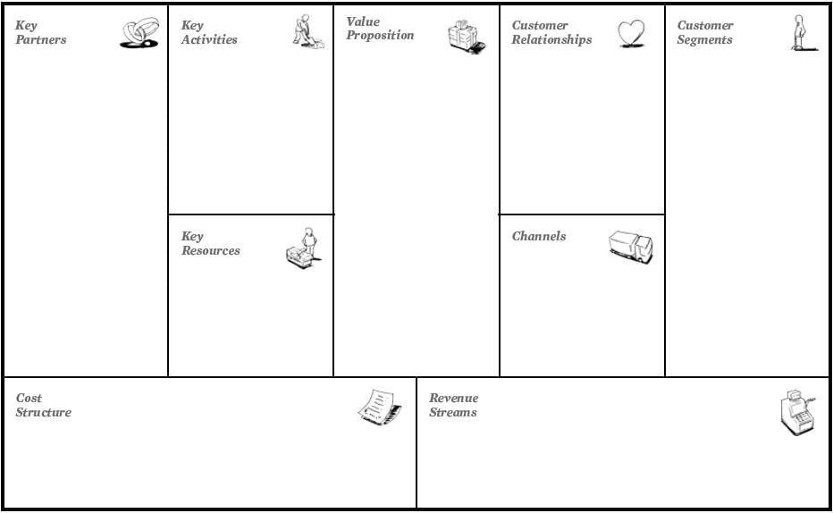

Slide 8
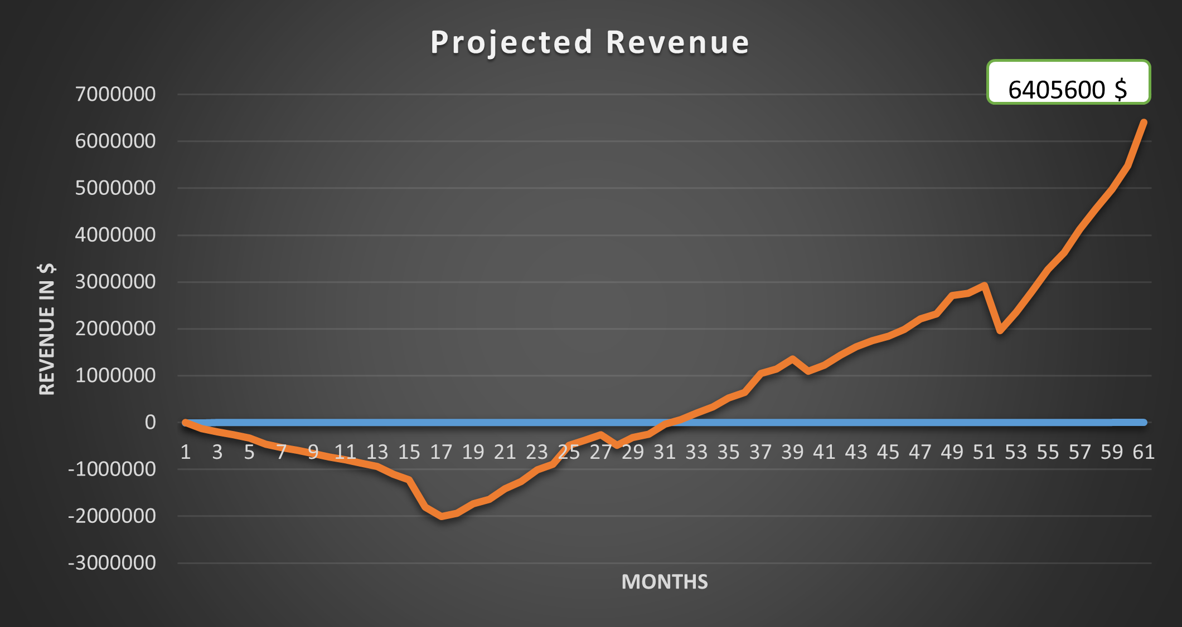
Financial Analysis

Slide 9
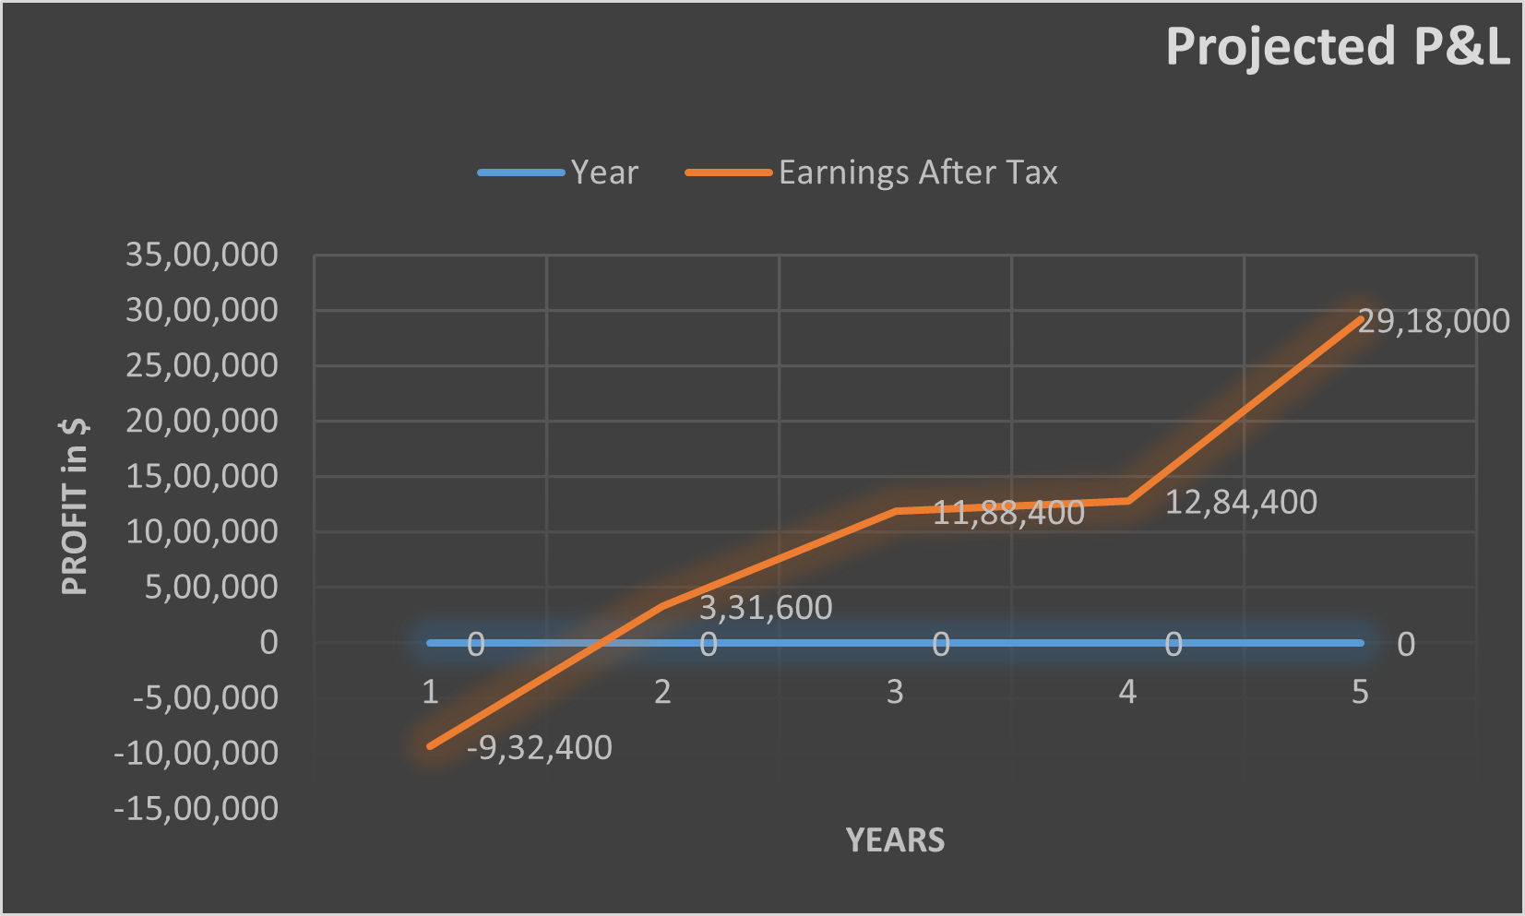
Financial Analysis

Slide 10
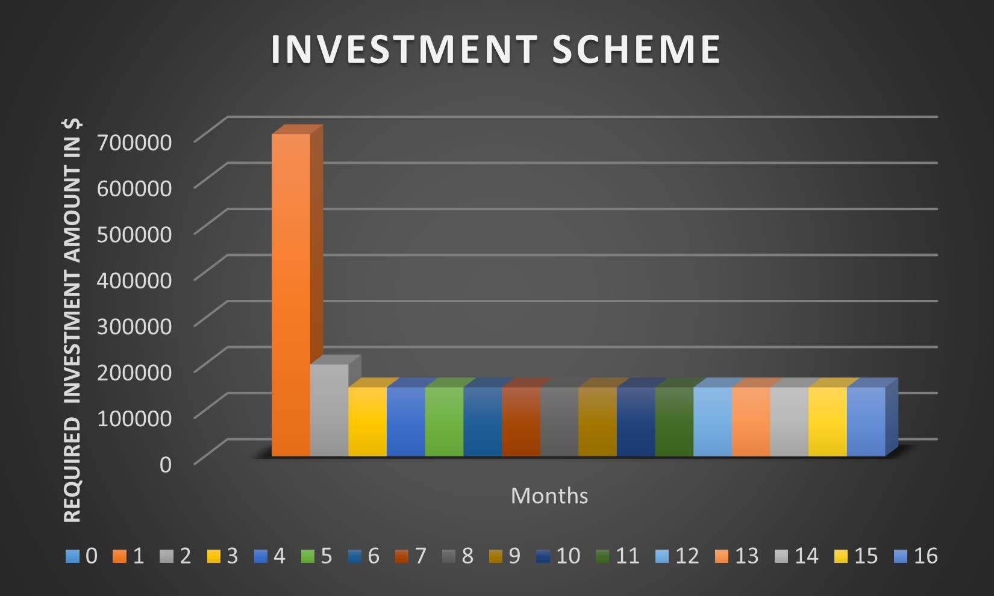
The ASK
We are raising seed round of $3,000,000 for 17.5% of the company

Slide 11

Minimum Viable Product

Slide 12
Identified customer
01
02
SMR
Space exploration
Our early adaptors for sensors.
They are also our early adaptors.
03
04
Military applications
Medical applications
Military application equipment has more lenient laws than civilian laws.
These would be our prospects.

Slide 13
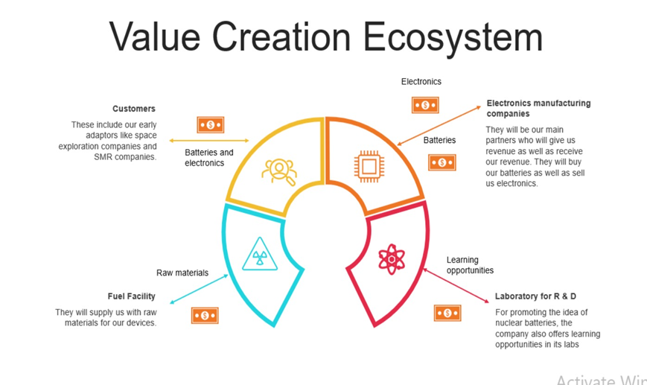


Notes:
For electronics manufacturing company: the electronics are for (temperature and pressure sensors)

Slide 14
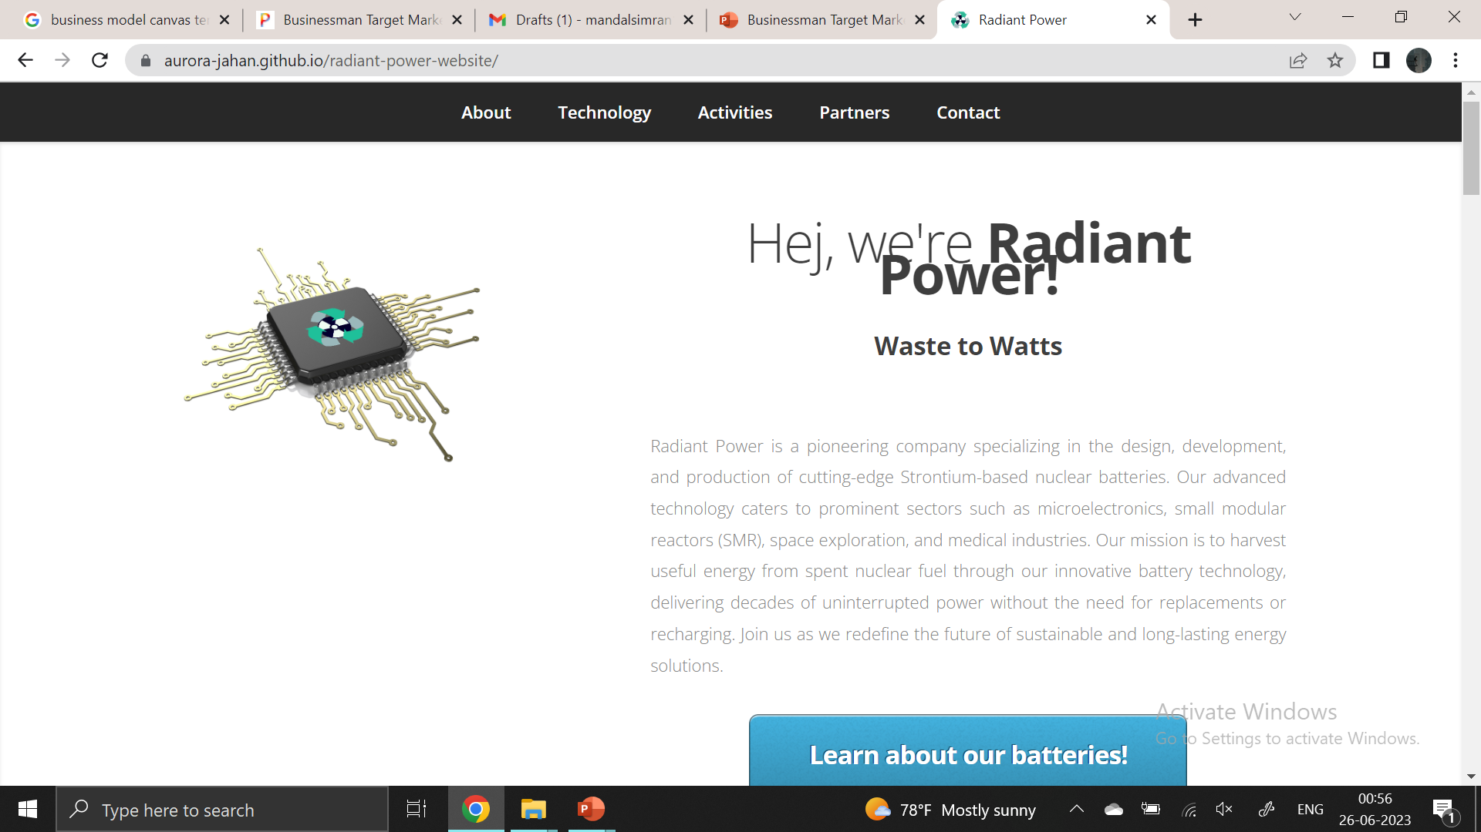
About us
Radiant Power is a pioneering company that designs, develops, and produces cutting-edge Strontium-based nuclear batteries. Our advanced technology caters to prominent sectors such as microelectronics, small modular reactors (SMR), space exploration, and medical industries. Our mission is to harvest useful energy from spent nuclear fuel through our innovative battery technology, delivering decades of uninterrupted power without replacing or recharging.

